Slide 1
Welcome to Javascript

Slide 2

Variables in JS
Variables are containers for storing data (values) that hold information and allow us access them later
All JavaScript variables must be identified with unique names
These unique names are called identifiers
We will think of this as a box that has a label on it.
var myNum;

Slide 3
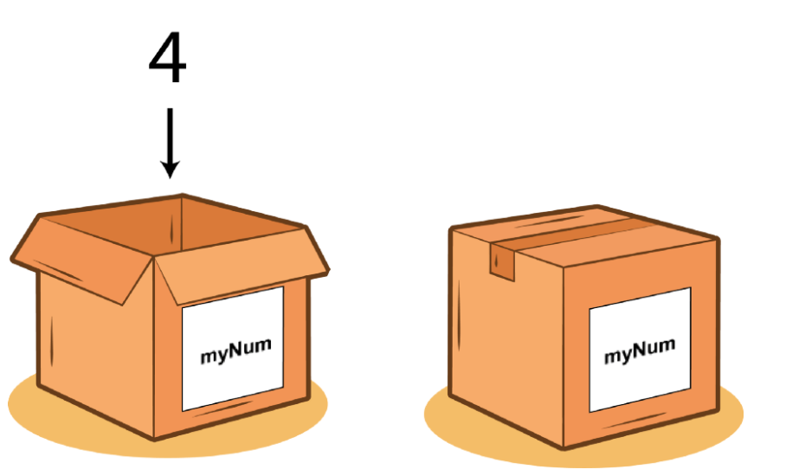
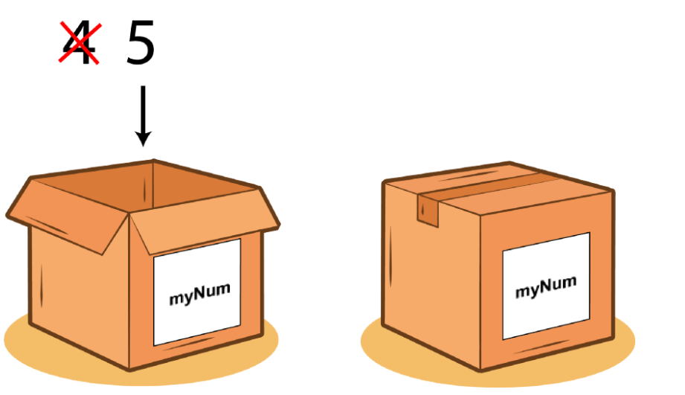
Variables in JS
We can visualise this a box that has a value added to it. Below we add 4 to myNum variable
var myNum = 4;
var myNum = 4
myNum = 5
Changing variables after initialisation (reassignment)

Slide 4
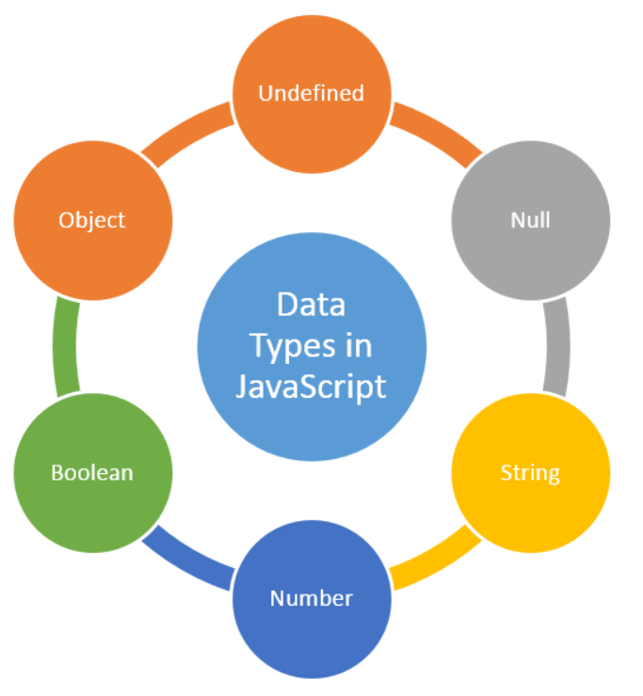
Data Types in JS
A data type specifies the type of data that a variable can store
JavaScript provides different data types to hold different types of values
Two types of data types
Primitive data type
Non-primitive (reference) data type
JavaScript is a dynamic type language,
means you don't need to specify type of the variable
var a= 10; //holding number
var b= "Ram"; //holding string

Slide 5
Primitive Data types
Data Type | Description
String | represents sequence of characters e.g. "hello"
Number | represents numeric values e.g. 100
Boolean | represents boolean value either false or true
Undefined | a data type whose variable is not initialized e.g. let a; you can say that undefined means lack of value or unknown value
Null | represents null i.e. no value at all
var b= "Ram"; //holding string
var a= 10; //holding number
Console.log(Boolean(10 > 9)) // boolean
var myVar = null;

Slide 6
Primitive Data types
null and undefined are primitive values in JavaScript.
A null value means absence.
An undefined value means lack of value.
A null or undefined value evalutes to false in conditional expression.

Slide 7
Non-Primitive Data types
Data Type | Description
Object | represents instance through which we can access members
Array | represents group of similar values
let person = {
firstName: 'John',
lastName: 'Doe'
};
var stringArray = [“John", “Doe"];
var numericArray = [1, 2, 3, 4];

Slide 8
JavaScript Operators
An operator performs some operation on single or multiple operands and produces a result
<Left operand> operator <right operand>
For example, in 1 + 2,
+ sign is an operator and
1 is left side operand and
2 is right side operand
Types of Operators
Arithmetic Operators
Comparison Operators
Logical Operators
Assignment Operators
Conditional Operators or Ternary Operator

Slide 9
JavaScript Operators - Arithmetic
Operator | Description
+ | Adds two numeric operands.
- | Subtract right operand from left operand
* | Multiply two numeric operands.
/ | Divide left operand by right operand.
% | Modulus operator. Returns remainder of two operands.
++ | Increment operator. Increase operand value by one.
-- | Decrement operator. Decrease value by one.
Example: Arithmetic Operation
var x = 5, y = 10;
var z = x + y; //performs addition and returns 15
z = y - x; //performs subtraction and returns 5
z = x * y; //performs multiplication and returns 50
z = y / x; //performs division and returns 2
z = x % 2; //returns division remainder 1
var x = 5;
x++; //post-increment, x will be 5 here and 6 in the next line
++x; //pre-increment, x will be 7 here
x--; //post-decrement, x will be 7 here and 6 in the next line
--x; //pre-decrement, x will be 5 here

